Slide 1
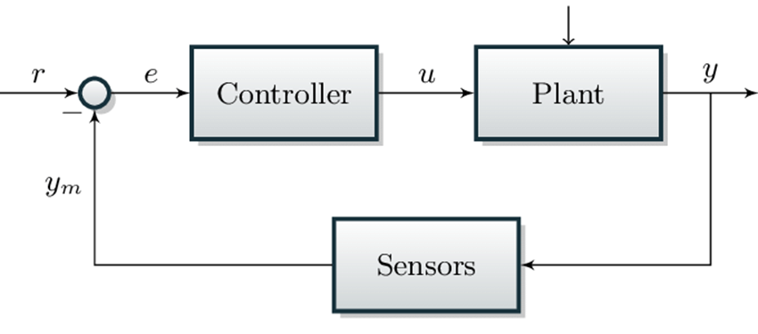
L6 Control
Zonghua Gu, Umeå University
Nov. 2023

Slide 2
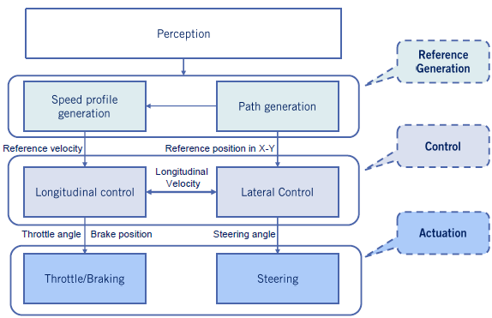
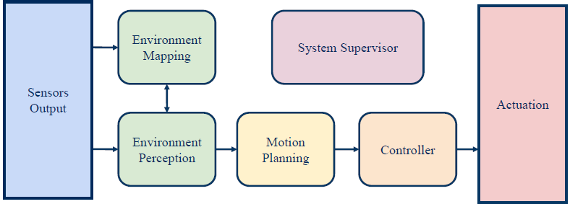
Control in the AD Pipeline
The controller outputs control commands (brake, acceleration, steering) to follow the trajectory output from motion planning
(Local Planning)

Slide 3
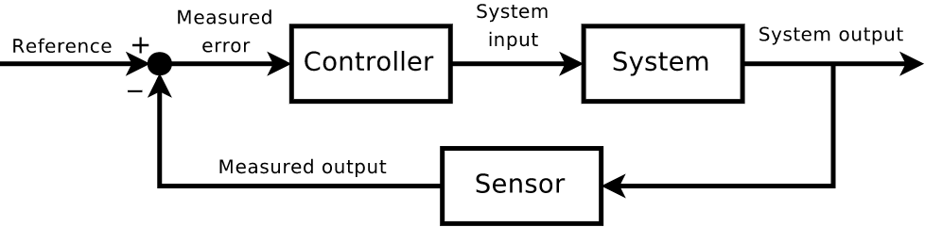
Feedback Control Problem
Given a system and a reference signal, find a control law such that the closed loop system is stable and follows the reference signal
The most common control algorithms in automotive systems are Proportional–Integral–Derivative (PID) and Model Predictive Control (MPC)

Slide 4
Outline
PID Control
MPC Control
Kinematic bicycle model
Twiddle() for PID control tuning

Slide 5
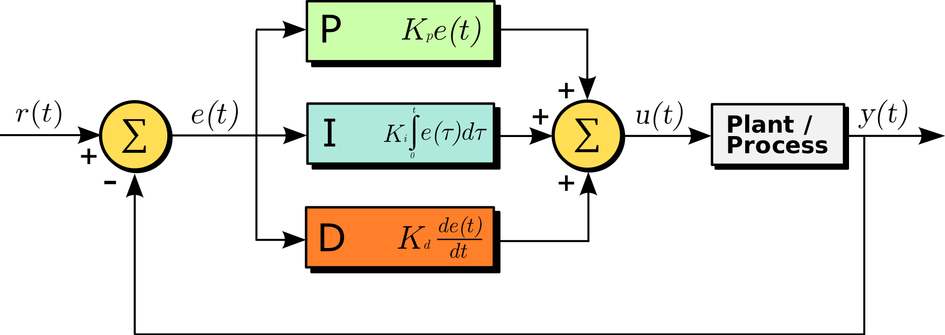

PID Control
Tracking Error: $e\left(t\right)=r\left(t\right)−y(t)$
Control input: $u\left(t\right)=K_{p}e\left(t\right)+K_{i}\int_{0}^{t}{e\left(τ\right)dτ}+K_{d}\dot{e}(t)$
Ref: Controlling Self Driving Cars
https://www.youtube.com/watch?v=4Y7zG48uHRo
https://en.wikipedia.org/wiki/PID_controller

Slide 6
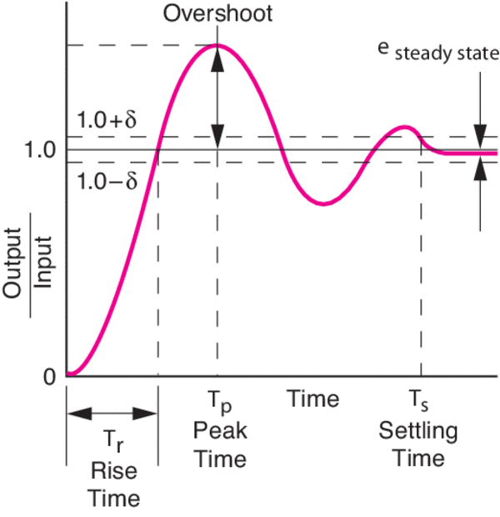
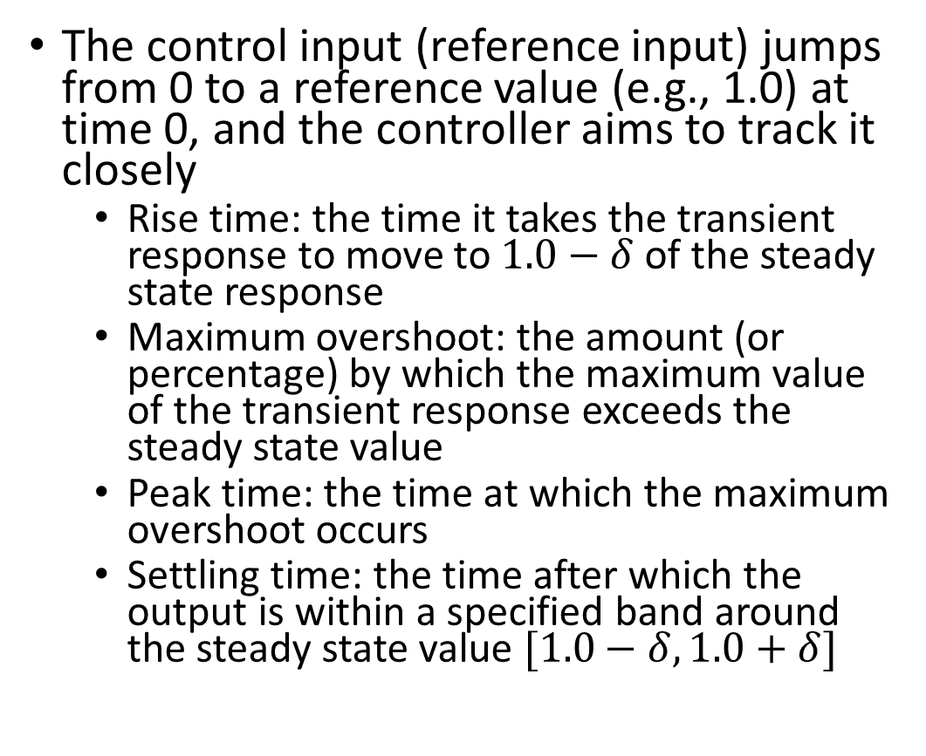
Step Response Performance Metrics
The control input (reference input) jumps from 0 to a reference value (e.g., 1.0) at time 0, and the controller aims to track it closely
Rise time: the time it takes the transient response to move to $1.0−δ$ of the steady state response
Maximum overshoot: the amount (or percentage) by which the maximum value of the transient response exceeds the steady state value
Peak time: the time at which the maximum overshoot occurs
Settling time: the time after which the output is within a specified band around the steady state value $[1.0−δ, 1.0+δ]$
https://www.newport.com/n/control-theory-terminology
Notes:
https://www.maplesoft.com/content/EngineeringFundamentals/11/MapleDocument_11/Block%20Diagrams,%20Feedback%20and%20Transient%20Response%20Specifications.pdf

Slide 7
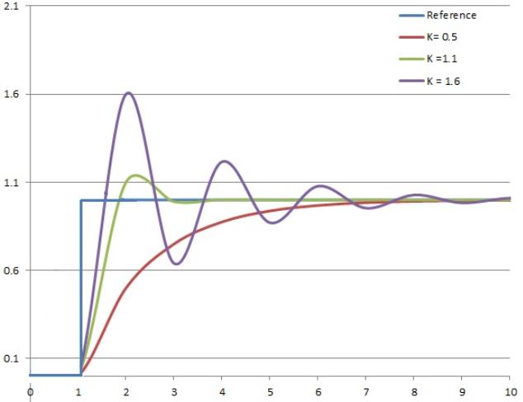
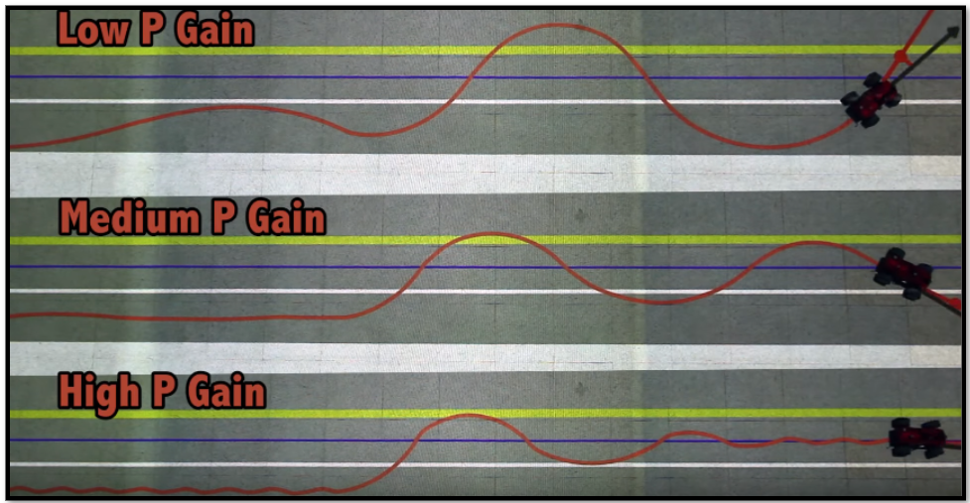
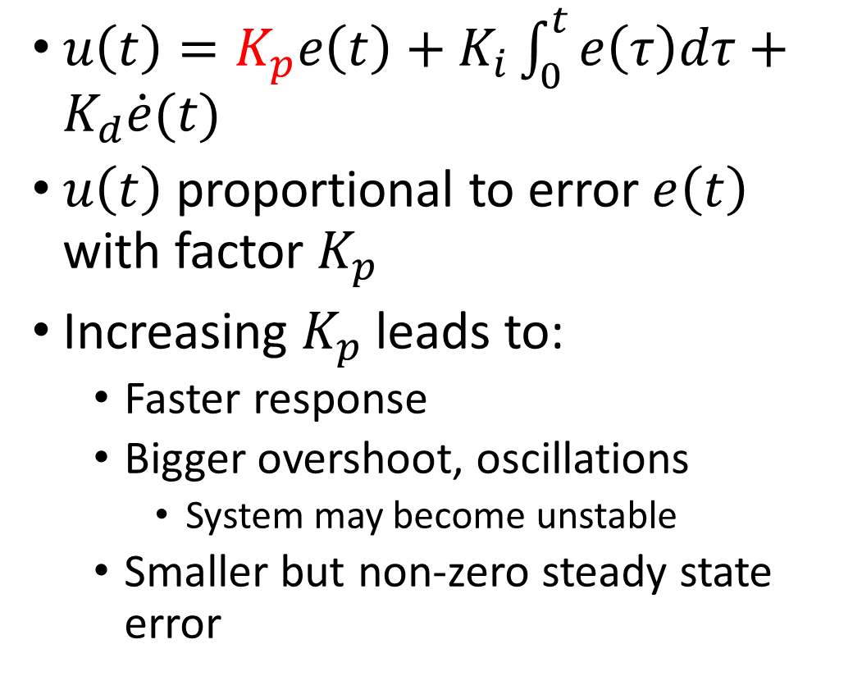
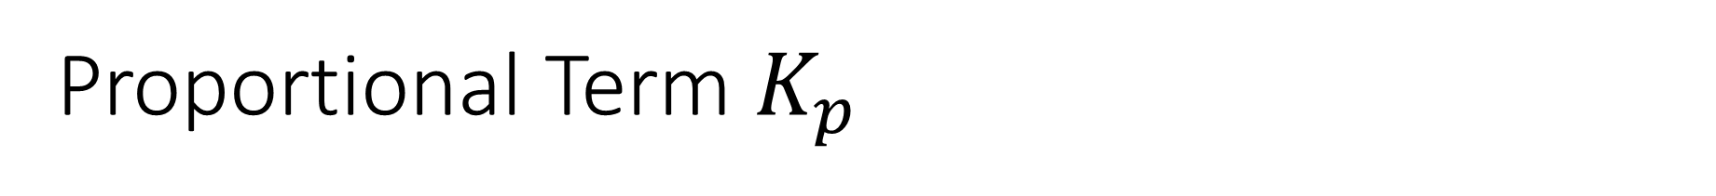
Proportional Term $K_{p}$
$u\left(t\right)=K_{p}e\left(t\right)+K_{i}\int_{0}^{t}{e\left(τ\right)dτ}+K_{d}\dot{e}(t)$
$u\left(t\right)$ proportional to error $e\left(t\right)$ with factor $K_{p}$
Increasing $K_{p}$ leads to:
Faster response
Bigger overshoot, oscillations
System may become unstable
Smaller but non-zero steady state error

Slide 8
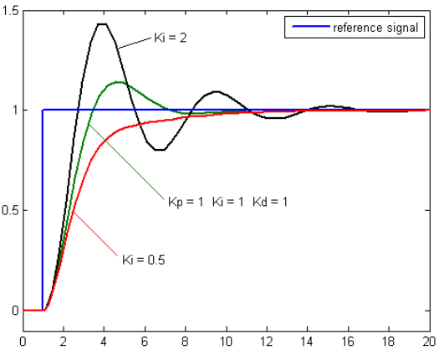
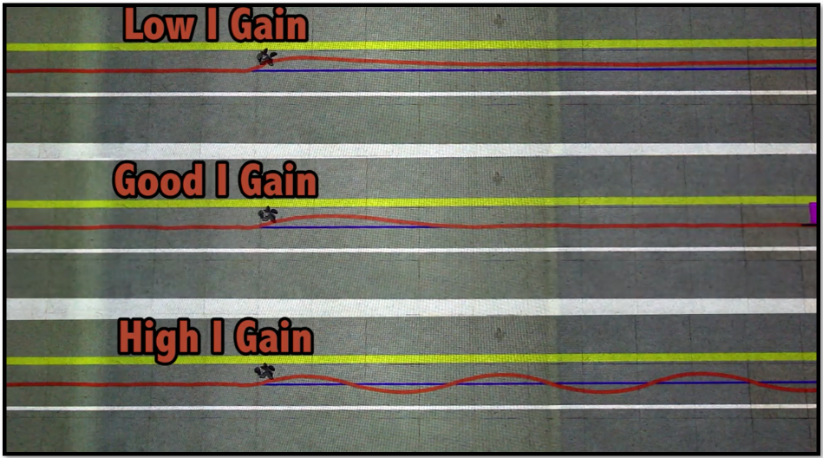
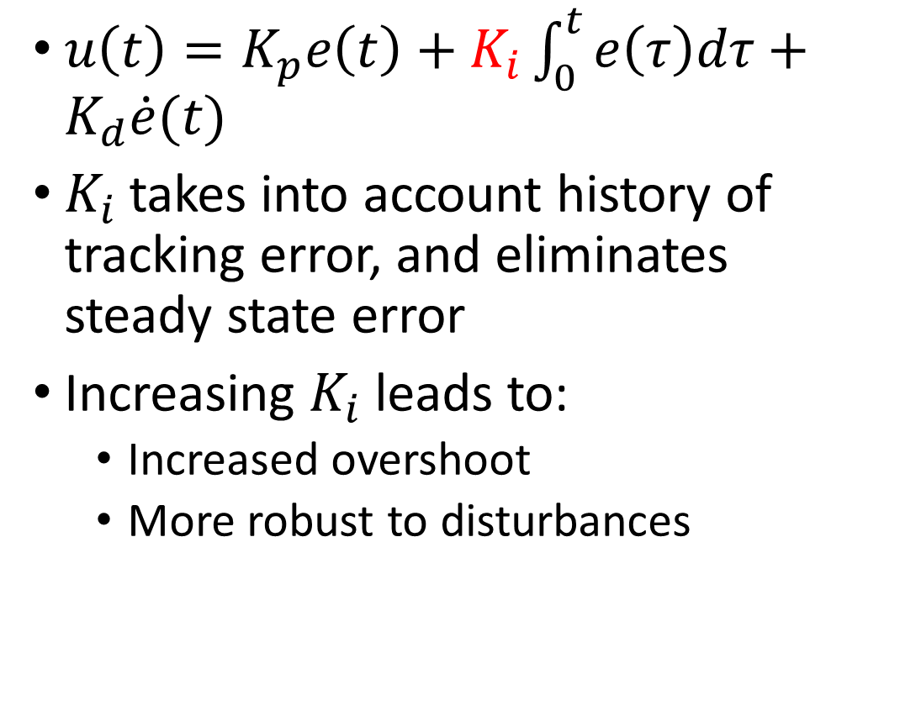
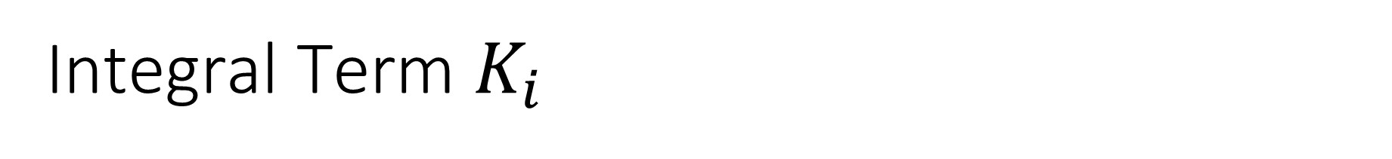
Integral Term $K_{i}$
$u\left(t\right)=K_{p}e\left(t\right)+K_{i}\int_{0}^{t}{e\left(τ\right)dτ}+K_{d}\dot{e}(t)$
$K_{i}$takes into account history of tracking error, and eliminates steady state error
Increasing $K_{i}$ leads to:
Increased overshoot
More robust to disturbances

Slide 9
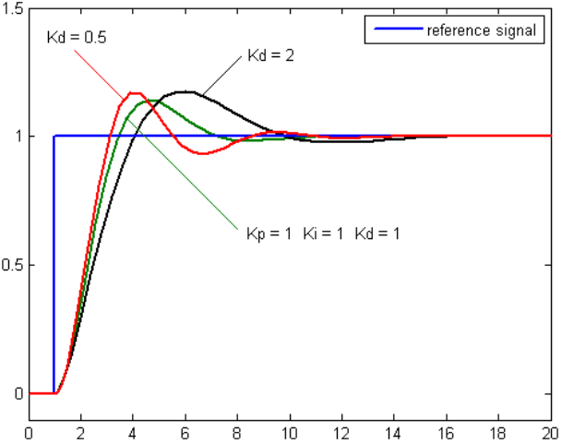
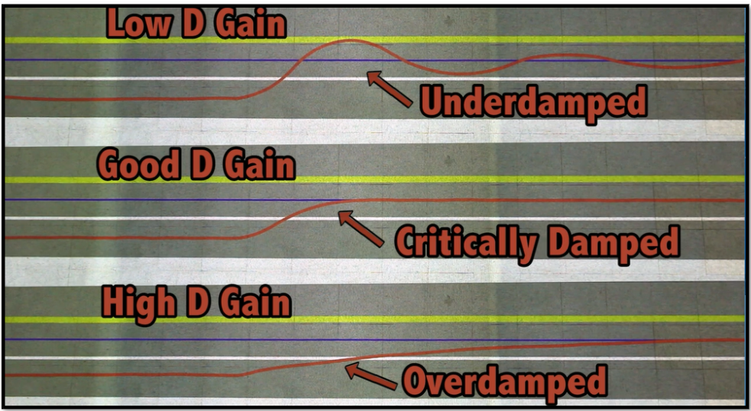
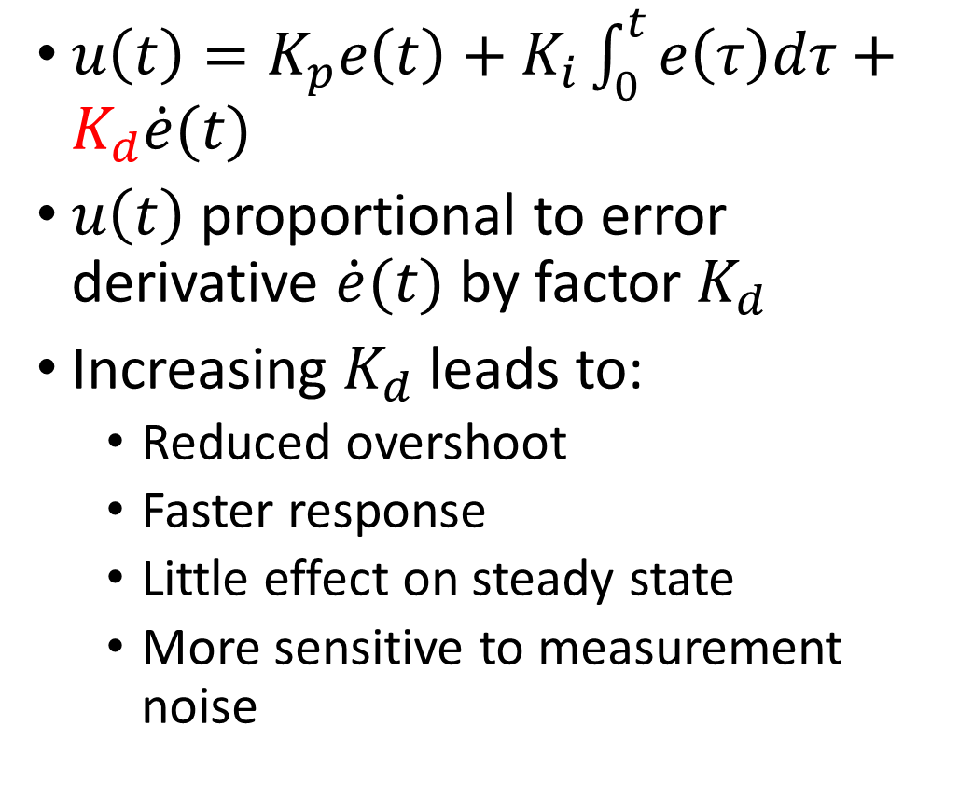
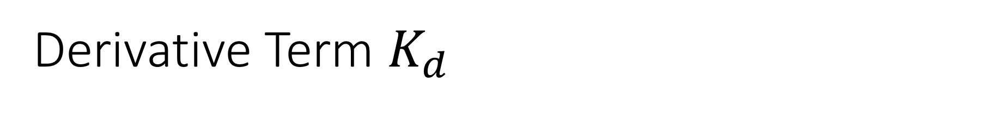
Derivative Term $K_{d}$
$u\left(t\right)=K_{p}e\left(t\right)+K_{i}\int_{0}^{t}{e\left(τ\right)dτ}+K_{d}\dot{e}(t)$
$u\left(t\right)$ proportional to error derivative $\dot{e}(t)$ by factor $K_{d}$
Increasing $K_{d}$ leads to:
Reduced overshoot
Faster response
Little effect on steady state
More sensitive to measurement noise

Slide 10
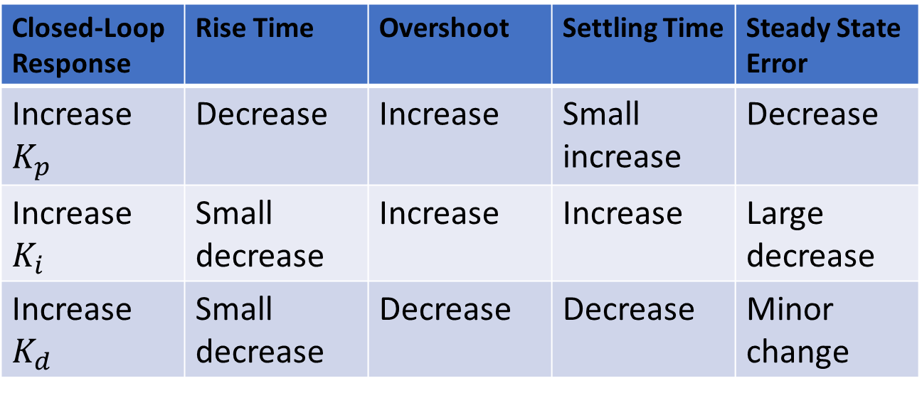

Effects of PID Gains
$u\left(t\right)=K_{p}e\left(t\right)+K_{i}\int_{0}^{t}{e\left(τ\right)dτ}+K_{d}\dot{e}(t)$
Closed-Loop Response | Rise Time | Overshoot | Settling Time | Steady State Error
Increase $K_{p}$ | Decrease | Increase | Small increase | Decrease
Increase $K_{i}$ | Small decrease | Increase | Increase | Large decrease
Increase $K_{d}$ | Small decrease | Decrease | Decrease | Minor change

Slide 11
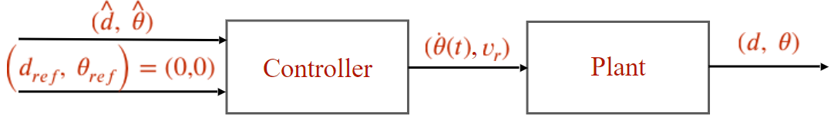
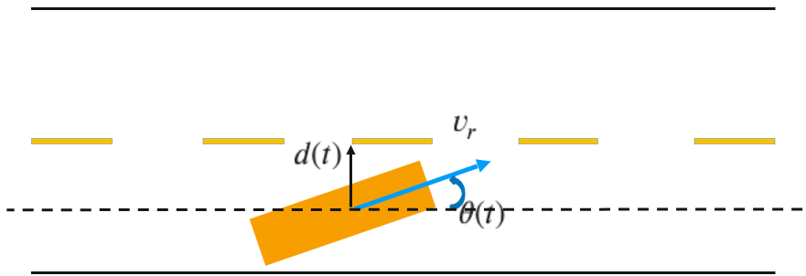
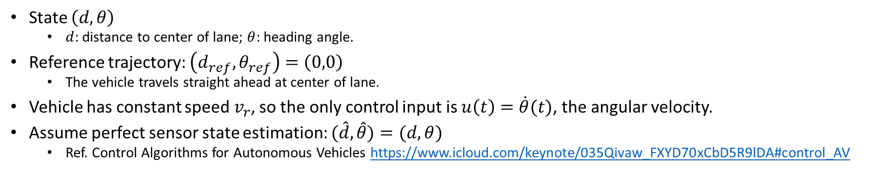
Example: Vehicle Lateral Control
State $\left(d,θ\right)$
$d$: distance to center of lane; $θ$: heading angle.
Reference trajectory: $\left(d_{ref},θ_{ref}\right)=\left(0,0\right)$
The vehicle travels straight ahead at center of lane.
Vehicle has constant speed $v_{r}$, so the only control input is $u\left(t\right)=\dot{θ}(t)$, the angular velocity.
Assume perfect sensor state estimation: $(\hat{d}, \hat{θ})=(d, θ)$
Ref. Control Algorithms for Autonomous Vehicles https://www.icloud.com/keynote/035Qivaw_FXYD70xCbD5R9lDA#control_AV
Notes:
https://www.icloud.com/keynote/035Qivaw_FXYD70xCbD5R9lDA#control_AV
Ref. Control Algorithms for Autonomous Vehicles https://www.icloud.com/keynote/035Qivaw_FXYD70xCbD5R9lDA#control_AV

Slide 12
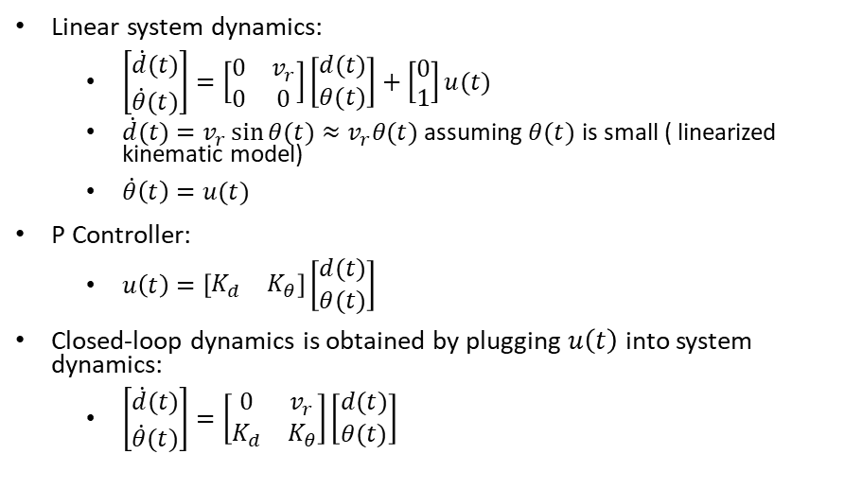
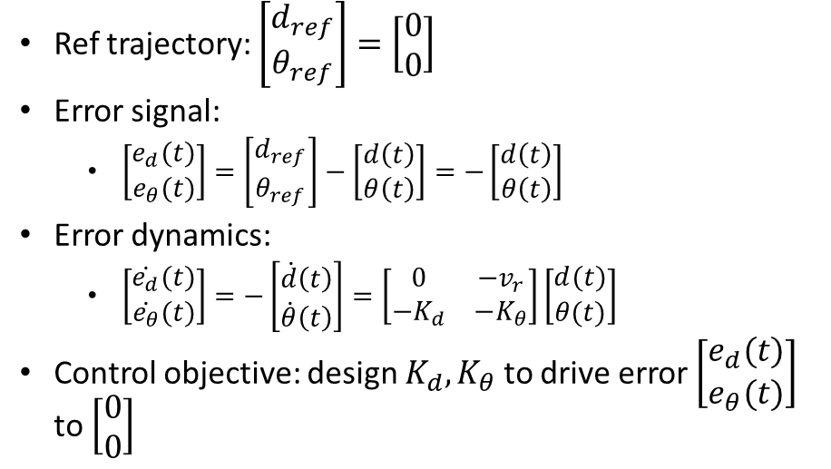
System and P Control Modeling
Linear system dynamics:
$\left[\begin{matrix}\dot{d}(t) \\ \dot{θ}(t)\end{matrix}\right]=\left[\begin{matrix}0 & v_{r} \\ 0 & 0\end{matrix}\right]\left[\begin{matrix}d(t) \\ θ(t)\end{matrix}\right]+\left[\begin{matrix}0 \\ 1\end{matrix}\right]u(t)$
$\dot{d}(t)=v_{r}\sin{θ(t)}≈$ $v_{r}θ(t)$ assuming $θ(t)$ is small ( linearized kinematic model)
$\dot{θ}\left(t\right)=u(t)$
P Controller:
$u\left(t\right)=\left[\begin{matrix}K_{d} & K_{θ}\end{matrix}\right]\left[\begin{matrix}d(t) \\ θ(t)\end{matrix}\right]$
Closed-loop dynamics is obtained by plugging $u\left(t\right)$ into system dynamics:
$\left[\begin{matrix}\dot{d}(t) \\ \dot{θ}(t)\end{matrix}\right]=\left[\begin{matrix}0 & v_{r} \\ K_{d} & K_{θ}\end{matrix}\right]\left[\begin{matrix}d(t) \\ θ(t)\end{matrix}\right]$
Ref trajectory: $\left[\begin{matrix}d_{ref} \\ θ_{ref}\end{matrix}\right]=\left[\begin{matrix}0 \\ 0\end{matrix}\right]$
Error signal:
$\left[\begin{matrix}e_{d}(t) \\ e_{θ}(t)\end{matrix}\right]=\left[\begin{matrix}d_{ref} \\ θ_{ref}\end{matrix}\right]−\left[\begin{matrix}d\left(t\right) \\ θ\left(t\right)\end{matrix}\right]=−\left[\begin{matrix}d\left(t\right) \\ θ\left(t\right)\end{matrix}\right]$
Error dynamics:
$\left[\begin{matrix}\dot{e_{d}}(t) \\ \dot{e_{θ}}(t)\end{matrix}\right]=−\left[\begin{matrix}\dot{d}\left(t\right) \\ \dot{θ}\left(t\right)\end{matrix}\right]=\left[\begin{matrix}0 & −v_{r} \\ {−K}_{d} & {−K}_{θ}\end{matrix}\right]\left[\begin{matrix}d(t) \\ θ(t)\end{matrix}\right]$
Control objective: design $K_{d},K_{θ}$ to drive error $\left[\begin{matrix}e_{d}(t) \\ e_{θ}(t)\end{matrix}\right]$ to $\left[\begin{matrix}0 \\ 0\end{matrix}\right]$

Slide 13
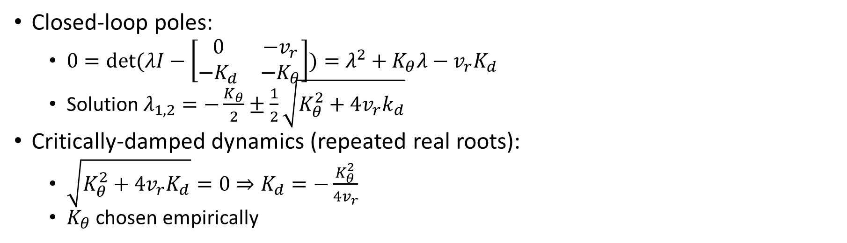
P Control Design with Pole Placement (not covered in this course)
Closed-loop poles:
$0=\det{(λI−\left[\begin{matrix}0 & −v_{r} \\ −K_{d} & {−K}_{θ}\end{matrix}\right])}=λ^{2}+K_{θ}λ−v_{r}K_{d}$
Solution $λ_{1,2}=−\frac{K_{θ}}{2}±\frac{1}{2}\sqrt{K_{θ}^{2}+4v_{r}k_{d}}$
Critically-damped dynamics (repeated real roots):
$\sqrt{K_{θ}^{2}+4v_{r}K_{d}}=0⇒K_{d}=−\frac{K_{θ}^{2}}{4v_{r}}$
$K_{θ}$ chosen empirically

Slide 14
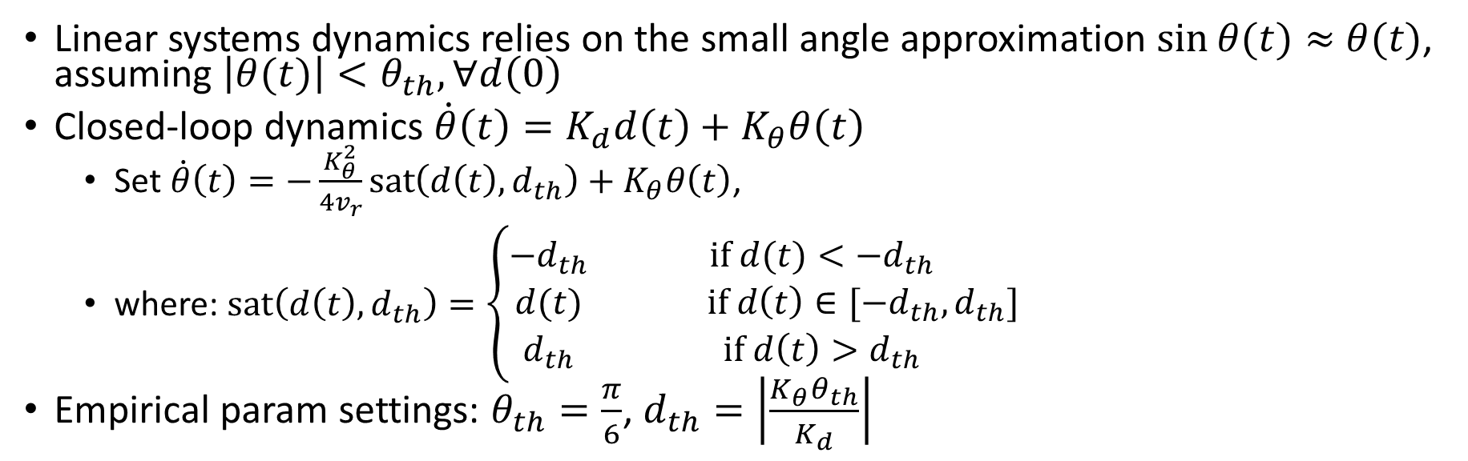
P Control Design Cont’d
Linear systems dynamics relies on the small angle approximation $\sin{θ(t)}≈$ $θ(t)$, assuming $\left|θ(t)\right|<θ_{th},∀d\left(0\right)$
Closed-loop dynamics $\dot{θ}\left(t\right)=K_{d}d\left(t\right)+K_{θ}θ\left(t\right)$
Set $\dot{θ}\left(t\right)=−\frac{K_{θ}^{2}}{4v_{r}}sat\left(d\left(t\right),d_{th}\right)+K_{θ}θ\left(t\right)$,
where: $\operatorname{sat}\left(d\left(t\right),d_{th}\right)=\left\{\begin{matrix}−d_{th} & if d(t)<−d_{th} \\ d(t) & if d\left(t\right)∈[−d_{th},d_{th}] \\ d_{th} & if {d\left(t\right)>d}_{th}\end{matrix}\right.$
Empirical param settings: $θ_{th}=\frac{π}{6}$, $d_{th}=\left|\frac{K_{θ}θ_{th}}{K_{d}}\right|$
Notes:
For example: to have $θ_{th}=\frac{π}{6}$, set $d_{th}=\left|\frac{K_{θ}θ_{th}}{K_{d}}\right|$
Even if the vehicle is very far from center of lane, do not change heading angle $θ(t)$ too fast (keep $\dot{θ}\left(t\right)$ small). (A heuristic rule-of-thumb, not a hard guarantee)

Slide 15
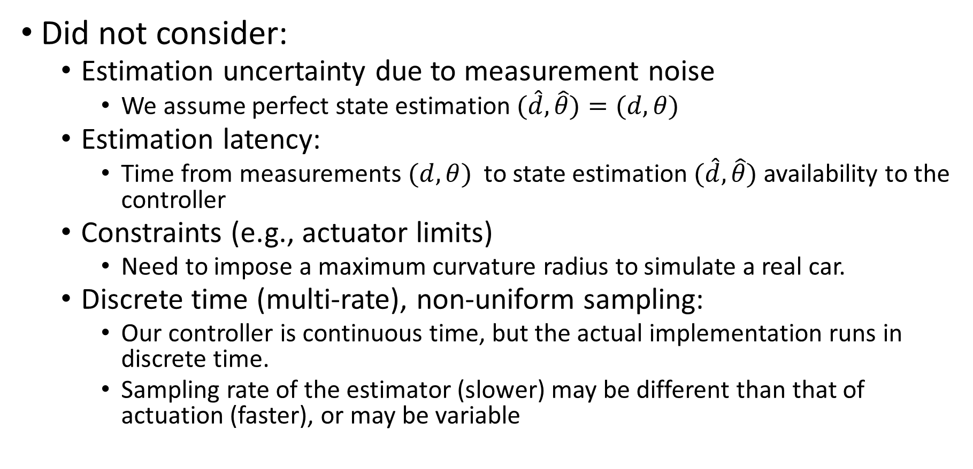
Simplifying Assumptions
Did not consider:
Estimation uncertainty due to measurement noise
We assume perfect state estimation $(\hat{d}, \hat{θ})=(d, θ)$
Estimation latency:
Time from measurements $(d, θ)$ to state estimation $(\hat{d}, \hat{θ})$ availability to the controller
Constraints (e.g., actuator limits)
Need to impose a maximum curvature radius to simulate a real car.
Discrete time (multi-rate), non-uniform sampling:
Our controller is continuous time, but the actual implementation runs in discrete time.
Sampling rate of the estimator (slower) may be different than that of actuation (faster), or may be variable

Slide 16
Outline
PID Control
MPC Control
Kinematic bicycle model
Twiddle() for PID control tuning

Slide 17
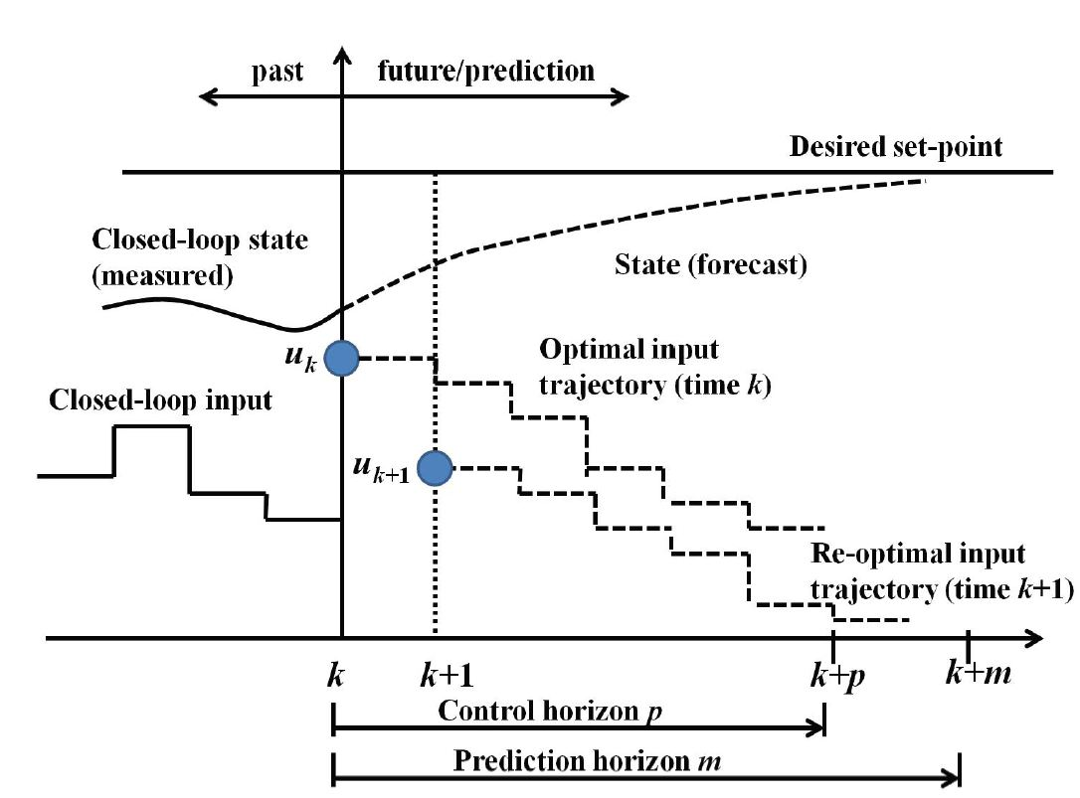
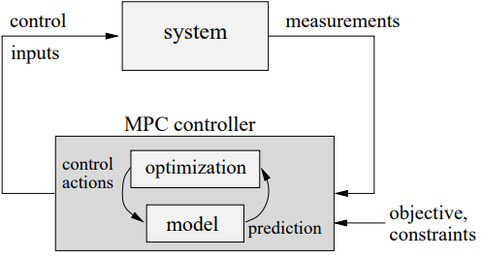
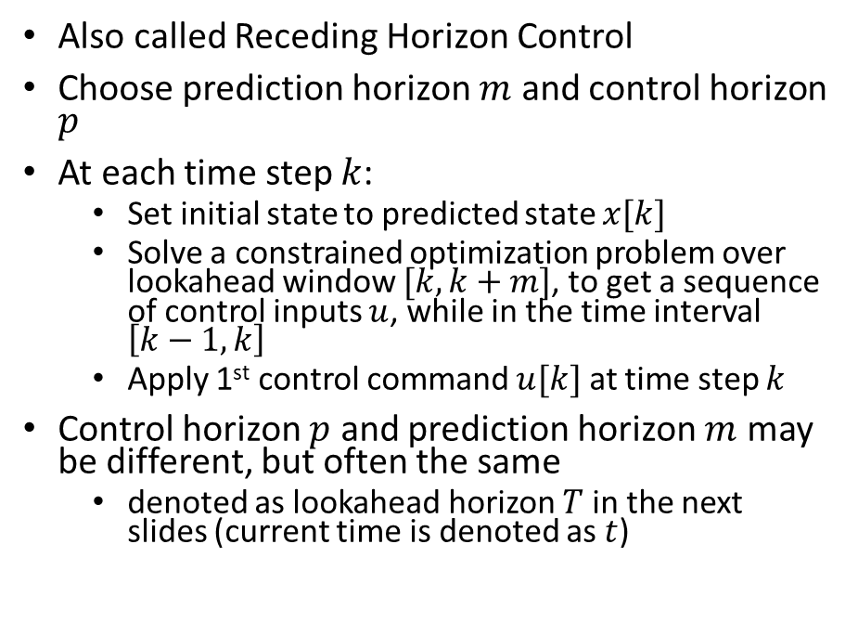
MPC (Model-Predictive Control)
Also called Receding Horizon Control
Choose prediction horizon $m$ and control horizon $p$
At each time step $k$:
Set initial state to predicted state $x[k]$
Solve a constrained optimization problem over lookahead window $[k,k+m]$, to get a sequence of control inputs $u$, while in the time interval $\left[k−1,k\right]$
Apply 1st control command $u[k]$ at time step $k$
Control horizon $p$ and prediction horizon $m$ may be different, but often the same
denoted as lookahead horizon $T$ in the next slides (current time is denoted as $t$)

Slide 18
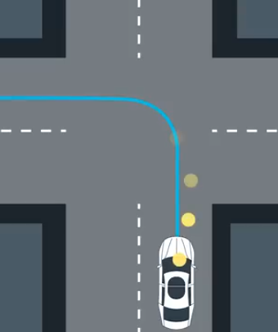
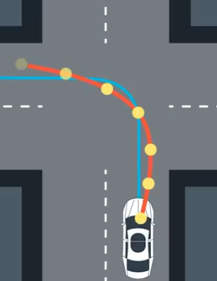
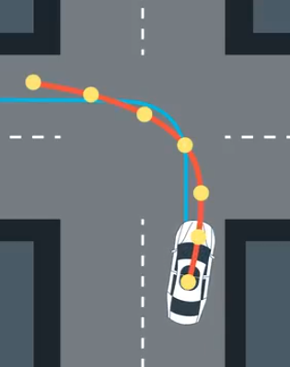
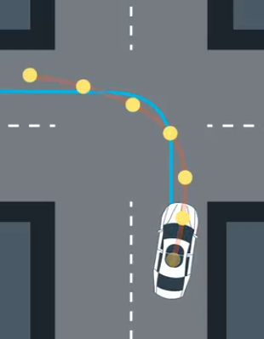
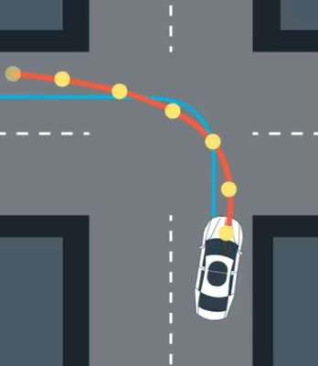


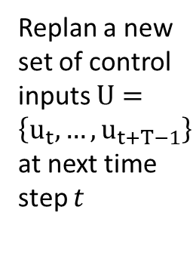

MPC Example
Solve for opt control inputs $U=\left\{u_{t},…,u_{t+T−1}\right\}$ within lookahead horizon $T$ to track the blue desired traj
Execute control input $u_{t}$
at 1st timestep
Execute control input $u_{t}$ at 1st timestep
Replan a new set of control inputs $U=\left\{u_{t},…,u_{t+T−1}\right\}$ at next time step $t$
…
Notes:
Input trajectory refers to computed control inputs $U=\left\{u_{k},…,u_{k+p−1}\right\}$

Slide 19
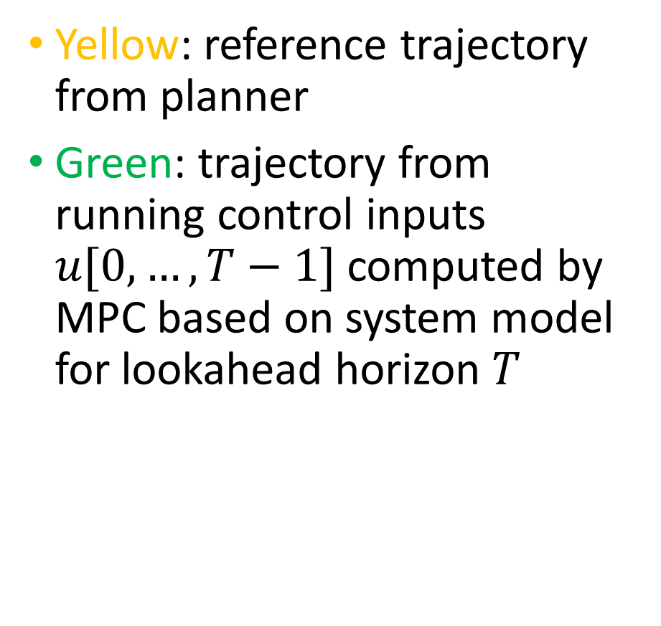
MPC Illustration Con’t
Yellow: reference trajectory from planner
Green: trajectory from running control inputs $u[0,…,T−1]$ computed by MPC based on system model for lookahead horizon $T$
https://medium.com/@david010/vehicle-mpc-controller-33ae813cf3be

Slide 20
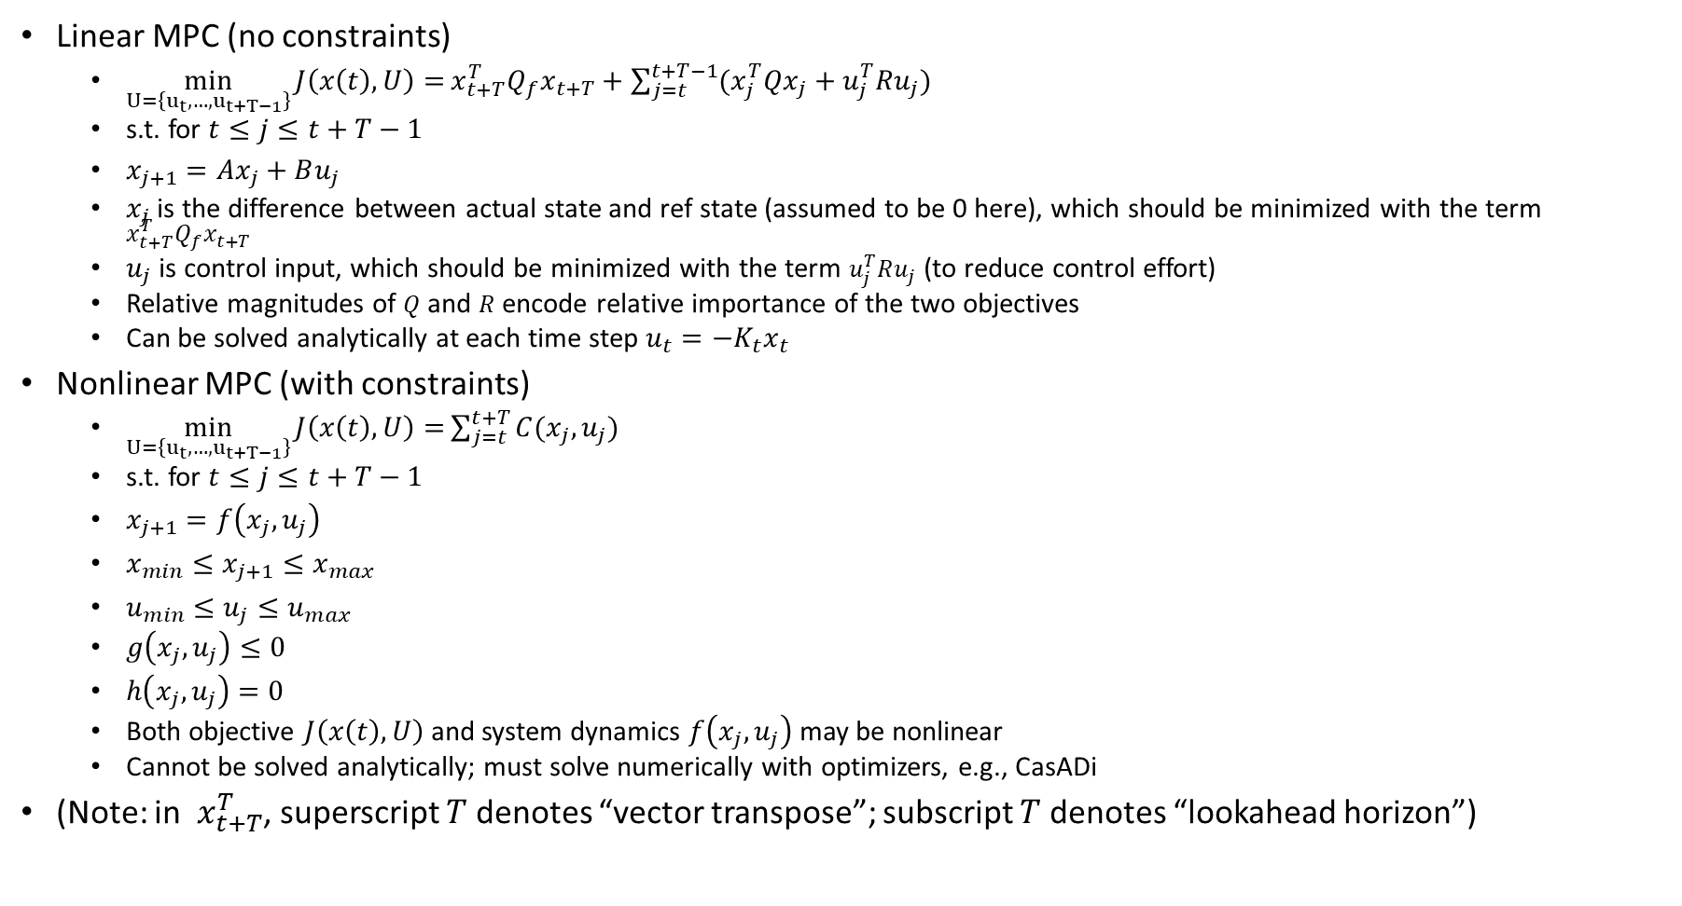
Linear vs. Nonlinear MPC
Linear MPC (no constraints)
$\min_{U=\left\{u_{t},…,u_{t+T−1}\right\}}{J\left(x\left(t\right),U\right)=}x_{t+T}^{T}Q_{f}x_{t+T}+\sum_{j=t}^{t+T−1}{(x_{j}^{T}Qx_{j}}+u_{j}^{T}Ru_{j})$
s.t. for $t≤j≤t+T−1$
$x_{j+1}=Ax_{j}+Bu_{j}$
$x_{j}$ is the difference between actual state and ref state (assumed to be 0 here), which should be minimized with the term $x_{t+T}^{T}Q_{f}x_{t+T}$
$u_{j}$ is control input, which should be minimized with the term $u_{j}^{T}Ru_{j}$ (to reduce control effort)
Relative magnitudes of $Q$ and $R$ encode relative importance of the two objectives
Can be solved analytically at each time step $u_{t}=−K_{t}x_{t}$
Nonlinear MPC (with constraints)
$\min_{U=\left\{u_{t},…,u_{t+T−1}\right\}}{J\left(x\left(t\right),U\right)=}\sum_{j=t}^{t+T}{C(x_{j},u_{j}) }$
s.t. for $t≤j≤t+T−1$
$x_{j+1}=f\left(x_{j},u_{j}\right)$
$x_{min}≤x_{j+1}≤x_{max}$
$u_{min}≤u_{j}≤u_{max}$
$g\left(x_{j},u_{j}\right)≤0$
$h\left(x_{j},u_{j}\right)=0$
Both objective $J\left(x\left(t\right),U\right)$and system dynamics $f\left(x_{j},u_{j}\right)$ may be nonlinear
Cannot be solved analytically; must solve numerically with optimizers, e.g., CasADi
(Note: in $x_{t+T}^{T}$, superscript $T$ denotes “vector transpose”; subscript $T$ denotes “lookahead horizon”)

Slide 21
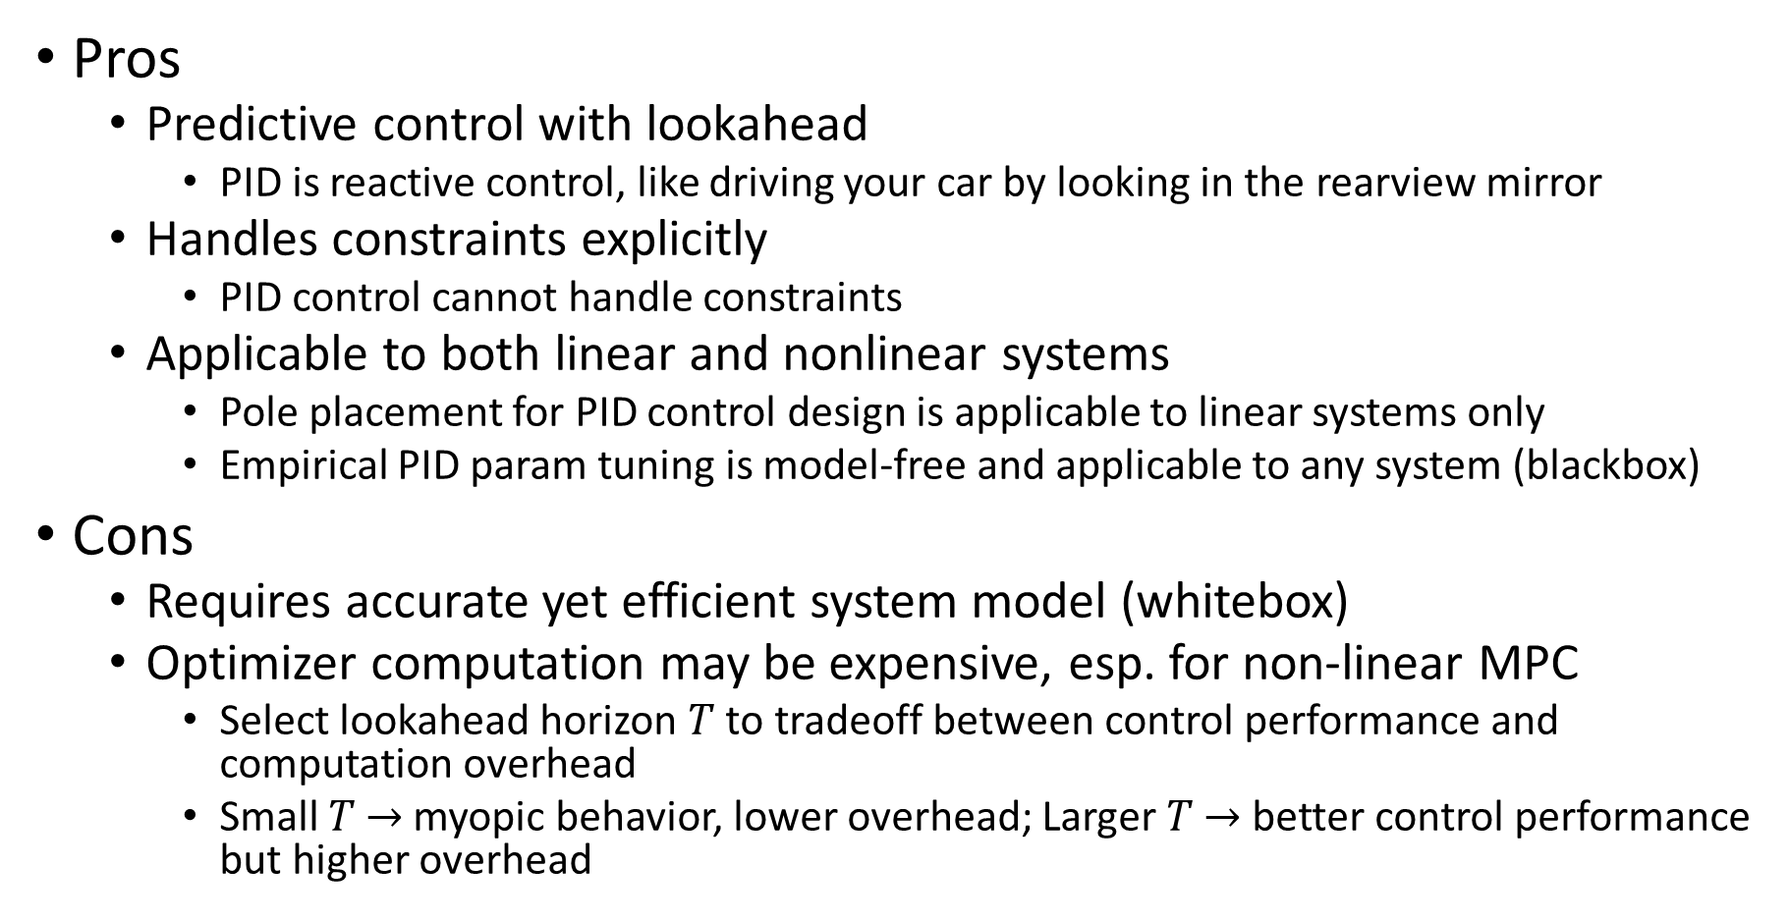
MPC Pros and Cons
Pros
Predictive control with lookahead
PID is reactive control, like driving your car by looking in the rearview mirror
Handles constraints explicitly
PID control cannot handle constraints
Applicable to both linear and nonlinear systems
Pole placement for PID control design is applicable to linear systems only
Empirical PID param tuning is model-free and applicable to any system (blackbox)
Cons
Requires accurate yet efficient system model (whitebox)
Optimizer computation may be expensive, esp. for non-linear MPC
Select lookahead horizon $T$ to tradeoff between control performance and computation overhead
Small $T$ $→$myopic behavior, lower overhead; Larger $T$ $→$ better control performance but higher overhead
Notes:
Pole placement for PID control design is applicable to linear systems only

Slide 22
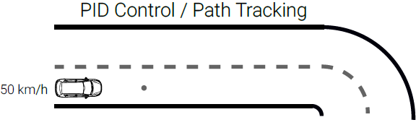
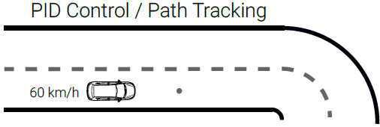
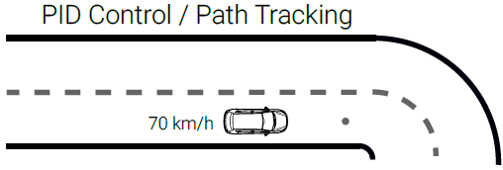
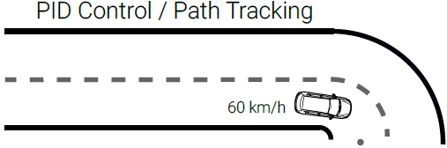
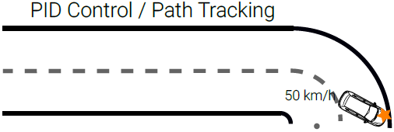
PID Control Example (No Look-Ahead)
Vehicle accelerates to track setpoint speed of 70 km/h
Then decelerates upon encountering a sharp turn, but it is too late and cannot track the lane
https://uni-tuebingen.de/fakultaeten/mathematisch-naturwissenschaftliche-fakultaet/fachbereiche/informatik/lehrstuehle/autonomous-vision/lectures/self-driving-cars/

Slide 23





MPC Control Example (Look-Ahead)
MPC computes control actions based on a lookahead window into the future
Vehicle decelerates early in anticipation of the sharp turn
https://uni-tuebingen.de/fakultaeten/mathematisch-naturwissenschaftliche-fakultaet/fachbereiche/informatik/lehrstuehle/autonomous-vision/lectures/self-driving-cars/

Slide 24

MPC Quiz
Which from the below statement about MPC are true?
1) Horizon is a finite window of time
2) Prediction horizon keeps being shifted at each time step
3) Full optimization over the time horizon is performed at each iteration
4) Only the first control action from the optimization is applied at time $t$
5) All of the above
ANS: 5

Slide 25
Outline
PID Control
MPC Control
Kinematic bicycle model
Twiddle() for PID control tuning

Slide 26

Kinematics vs. Dynamics
Kinematics is study of motion without considering the forces that affect the motion. It deals with the geometric relationships that govern the system
A kinematic model: $\dot{x}=v, \dot{v}=\ddot{x}=a$
Uses position, velocity, acceleration (and/or further derivatives) as control input (e.g. the kinematic bicycle model)
Dynamics is the study of motion taking into account the forces that affect it. It is described by the equations of motion.
A dynamic model: $F=M\ddot{x}+B\dot{x}=Ma+Bv$ (Newton’s law with friction)
Uses force and torque as control input, and takes mass and inertia into consideration.
e.g., vehicle dynamics model (longitudinal and lateral)
Consider two vehicles with the same geometry but different mass/weight turning a tight corner
They may have the same kinematic model, but different dynamic model due to different mass $M$.
Both may be controllable kinematically by control input $a$
The light vehicle may be controllable dynamically by control input $F$.
The heavy vehicle may not be controllable dynamically by control input $F$. Due to large $M$, $F$ may exceed the max actuator limit.
Orthogonal issue from control algorithm
Control algorithms, e.g., PID or MPC, may be either kinematic or dynamic control

Slide 27


Kinematic vs. Dynamic Control
PID controller for kinematic bicycle model with heading angle rate $(\dot{θ})$ and velocity $(v_{r}$, constant here) as control input. ($\dot{θ}$ should be controlled indirectly by controlling steering angle $δ$, with $\dot{θ}=\frac{v\tan{δ}}{L}$.)
MPC for dynamic vehicle model (high-level controller) with forces (longitudinal and lateral) as control input.

Slide 28







Kinematic Bicycle Model
Front wheel steering. Assuming here rear wheel as reference point (may also use front wheel or center of gravity).
State vector: ${\left[\begin{matrix}x & y & θ\end{matrix}\right]}^{T}$: vehicle pose includes its position $(x,y)$ and heading angle $θ$.
Control inputs: ${\left[\begin{matrix}δ & v\end{matrix}\right]}^{T}$: steering angle $δ$ and vehicle speed $v$ (assumed to be constant).
$\tan{δ}=\frac{L}{R}$
$L$: vehicle length (distance between 2 wheels); $R$: rotation radius of Instantaneous Center of Rotation (ICR), equal to distance between ICR and rear wheel. Curvature $κ=\frac{1}{R}$.
Line from ICR to each wheel is perpendicular to it.
$\dot{θ}=ω=\frac{v}{R}=\frac{v\tan{δ}}{L}$
Angular velocity is speed $v$ divided by rotation radius $R$
Typically, angles $δ,θ$ are based on counter-clockwise convention w.r.t reference direction.
In the fig, $δ≈\frac{π}{6}$ w.r.t ref direction $v$; $θ≈\frac{π}{6}$ w.r.t ref direction east (horizontal); $\dot{θ}>0$ for counter-clockwise rotation.
$$π/2$$
$$π/2$$
$$(x,y)$$
$$\left[\dot{\begin{matrix}x \\ \dot{y} \\ \dot{θ}\end{matrix}}\right]=v\left[\begin{matrix}\cos{θ} \\ \sin{θ} \\ \frac{\tan{δ}}{L}\end{matrix}\right]$$
(Non-linear in $δ$;
Linear in $v$)

Slide 29








State Update in Python Code
# apply noise
steering2 = random.gauss(steering, self.steering_noise)
distance2 = random.gauss(distance, self.distance_noise)
# apply steering drift
steering2 += self.steering_drift
# noise and drift are all set to 0, so steering2 is steering angle $δ$, distance2 is distance traveled per time step $vdt$
# Execute motion
turn = np.tan(steering2) * distance2 / self.length ($\dot{θ}dt=\frac{vdt tan{δ}}{L}$)
if abs(turn) < tolerance: (with small $\dot{θ}dt$)
# approximate by straight line motion
self.x += distance2 * np.cos(self.orientation) ($x+=vdt\cos{θ}$)
self.y += distance2 * np.sin(self.orientation) ($y+=vdt\sin{θ}$)
self.orientation = (self.orientation + turn) % (2.0 * np.pi) ($θ=(θ+\dot{θ}dt$)%($2π$))
else: (with large $\dot{θ}dt$)
# Circular motion around ICR
radius = distance2 / turn ($R=\frac{v}{\dot{θ}}$; can also use $R=\frac{L}{\tan{δ}}$)
# compute ICR’s coordinates (cx, cy)
cx = self.x - (np.sin(self.orientation) * radius) ($cx=x−R\sin{θ}$)
cy = self.y + (np.cos(self.orientation) * radius) ($cy=y+R\cos{θ}$)
self.orientation = (self.orientation + turn) % (2.0 * np.pi) ($θ=(θ+\dot{θ}dt\text{)\%(}2π\text{)}$)
# compute vehicle’s x, y coordinate after rotation around ICR
self.x = cx + (np.sin(self.orientation) * radius) ($x=cx+R\sin{θ}$)
self.y = cy - (np.cos(self.orientation) * radius) ($y=cy−R\cos{θ}$)
$$(cx,cy)$$
$$θ$$
$$R\cos{θ}$$
$\%(2π)$ (modulo $2π$) keeps angles to be within $2π$; It can be omitted since it does not affect results of $cos,sin$ functions (assuming no numeric overflow).
$$−R\sin{θ}$$
$$(x,y)$$

Slide 30

State Update Equation
Circular motion around ICR (accurate):
$\left[\begin{matrix}x(t+dt) \\ y\left(t+dt\right) \\ θ(t+dt)\end{matrix}\right]=\left[\begin{matrix}x(t)−R\sin{θ}+R\sin{(θ}+\dot{θ}dt) \\ y\left(t\right)+R\cos{θ}−R\cos{(θ}+\dot{θ}dt) \\ θ+\dot{θ}dt\end{matrix}\right]$
$R=\frac{L}{\tan{δ}}=\frac{v}{\dot{θ}}$
Straight-line motion for small $\dot{θ}dt$ (approximate):
$\left[\begin{matrix}x(t+dt) \\ y\left(t+dt\right) \\ θ(t+dt)\end{matrix}\right]=\left[\begin{matrix}x\left(t\right)+vdt\cos{θ} \\ y\left(t\right)+vdt\sin{θ} \\ θ+\dot{θ}dt\end{matrix}\right]$
$δ→0,\dot{θ}dt→0$

Slide 31

Straight Line vs. Circular Motion
Straight line motion (with steering angle $δ=0$) is a special case of circular motion with radius $∞$.
$δ→0⇒R=\frac{L}{\tan{δ}}→∞,\dot{θ}=\frac{v}{R}→0$ (small steering angle $δ$ leads to slow angular velocity $\dot{θ}$.)
We use this special case to improve computational efficiency for small $δ,\dot{θ}$, and avoid division by 0.
$x(t+dt)=x(t)−R\sin{θ}+R\sin{(θ}+\dot{θ}dt)=x+R(\sin{(θ}+\dot{θ}dt)−sin⁡θ)=x+\frac{v}{\dot{θ}}∗\cos{θ}∗\dot{θ}dt= x+vdt\cos{θ}$
$\sin{(θ}+\dot{θ}dt)−\sin{θ}≈\frac{d}{dt}\sin{θ}∗\dot{θ}dt=\cos{θ}∗\dot{θ}dt$, for small $\dot{θ}dt$.
$y\left(t+dt\right)=y\left(t\right)+R\cos{θ}−R\cos{(θ}+\dot{θ}dt)=y−R(\cos{(θ}+\dot{θ}dt)−cos⁡θ)=y+\frac{v}{\dot{θ}}∗\sin{θ}∗\dot{θ}dt=y+vdt\sin{θ}$
$\cos{(θ}+\dot{θ}dt)−\cos{θ}≈\frac{d}{dt}\cos{θ}∗\dot{θ}dt=−\sin{θ}∗\dot{θ}dt$, for small $\dot{θ}dt$.
Four special cases of straight line motion:
$θ=0⇒x^{′}=x+vdt,y^{′}=y$ (east)
$θ=π⇒x^{′}=x−vdt,y^{′}=y$ (west)
$θ=\frac{π}{2}⇒x^{′}=x,y^{′}=y+vdt$ (north)
$θ=\frac{3π}{2}⇒x^{′}=x,y^{′}=y−vdt$ (south)

Slide 32
PID Control Lab Setup
Based on Udacity course Lesson AI for Robotics, Lesson 15: PID Control
https://classroom.udacity.com/courses/cs373/
Lateral control of a car to run along a race track (either straight line or circular) with fixed speed.

Slide 33
Outline
PID Control
MPC Control
Kinematic bicycle model
Twiddle() for PID control tuning

Slide 34


Udacity: Racetrack Control
Lesson 16: Problem Set 5, 4. Quiz: Racetrack control.
Cross-track error (cte): lateral distance (of rear wheel) to desired trajectory, defined as:
if $x∈[radius, 3∗radius]$: deviation from the straight horizontal track (with the implicit assumption that the car will not deviate from the track for more than $radius$.)
Otherwise: deviation from each semi-circle track.
For clockwise traversal, cte>0 if car is outside of the track region; cte<0 if inside.
cte>0
cte>0
Initial pose
cte<0
cte<0

Slide 35


run()
Implements the PID controller for with PID gains
params[0] as $K_{p}$; params[1] as $K_{d}$; params[2] as $K_{i}$.
Returns actual trajectory as arrays of x_trajectory[], y_trajectory[]; and average error, defined as sum of squared cte
For clockwise travel direction:
If cte>0, car is outside of track region; steering angle $δ$ should decrease (turn right according to the counter-clockwise convention)
If cte<0, car is inside of track region; steering angle $δ$ should increase (turn left)
Based on the above, $K_{p}$ should be positive (this can be a sanity check for your final solution)
This is for straight line track; need to call myrobot.cte() for circular track.
PID control law
Notes:
(Minus signs can be removed without affecting correctness.)

Slide 36


For General $dt$
The Python code assumes controller time step size $dt=1$.
Also, $v$ is constant. $δ$’s range is unconstrained (steering wheel can be turned to arbitrary angle).
For general $dt$, the following needs to be modified:
Call myrobot.move(steer, speed*dt), to match its definition move(self, steering, distance,…)
In the PID control law:
Differential of error$diffcte=\frac{cte−prevcte}{dt}$
Integral of error$intcte+=cte∗dt$

Slide 37





twiddle()
twiddle: “twist, move, or fiddle with (something), typically in a purposeless or nervous way” –Encyclopedia.
Adjust each $p\left[i\right]$ in turn.
Update $p\left[i\right]$ to $p\left[i\right]+dp[i]$ and run(). If error decreases, then $p\left[i\right]$ was updated in the right direction. Keep the update $+dp[i]$ to get $p\left[i\right]+dp[i]$, and increase step size to $1.1∗dp\left[i\right]$.
If error increases, then $p\left[i\right]$ was updated in the wrong direction. Update in the opposite direction by $−2∗dp[i]$ to get $p\left[i\right]−dp[i]$. Run again.
If error decreases, then $p\left[i\right]$ was updated in the right direction. Keep the current $p\left[i\right]−dp[i]$, and increase step size to $1.1∗dp\left[i\right]$.
If error increases, then $p\left[i\right]$ was updated in the wrong direction. Update in the opposite direction by +$dp[i]$ to get back the original $p\left[i\right]$ . Reduce step size to $.9∗dp\left[i\right]$.

Slide 38


Changing to P Control
Setting $dparams\left[1\right]=dparams\left[2\right]=0$ turns it into a P controller, since $K_{d},K_{i}$ are initialized to 0 and never changed. $K_{p}$ is adjusted in twiddle()
twiddle() is a local optimization algorithm, so perf is dependent on parameter initialization. Here are initialized to 0 for simplicity.
https://classroom.udacity.com/courses/cs373/lessons/91f48b5b-a063-41f9-ace6-5fb9e7508941/concepts/b740218e-b0eb-40dc-80af-343912305293

Slide 39

twiddle() vs. Pole Placement
twiddle() is a model-free approach to tuning PID controller by Gradient descent. It adjusts each PID gain parameter systematically, gradually decreasing or increasing step of adjustment $dp[i]$ (the gradient) until convergence to minimum best_err.
Pole placement for PID controller design is model-based, but requires a linear model
$\left[\dot{\begin{matrix}x \\ \dot{y} \\ \dot{θ}\end{matrix}}\right]=v\left[\begin{matrix}\cos{θ} \\ \sin{θ} \\ \frac{\tan{δ}}{L}\end{matrix}\right]≈\left[\begin{matrix}v \\ vθ \\ u\end{matrix}\right]$
With simplifying assumptions:
$θ$ is small
Simplified kinematic model: $u=\dot{θ}$ as control input instead of $δ$

